Slide 1
Lab 5
Yichen Sheng

Slide 2
Device
CPU: Intel Xeon(R) W-2145 3.70GHz
RTX 2080

Slide 3
Demos
(In case CMake(source codes) cannot work in Windows)

Slide 4
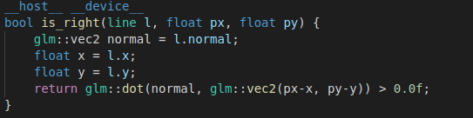
Codes
Line side

Slide 5
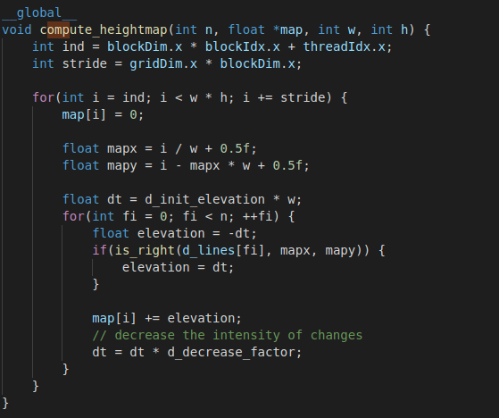
Codes
Fault algorithm
Initial elevation
Constant memory
Choose side
Accumulate height
Elevation attenuation

Slide 6
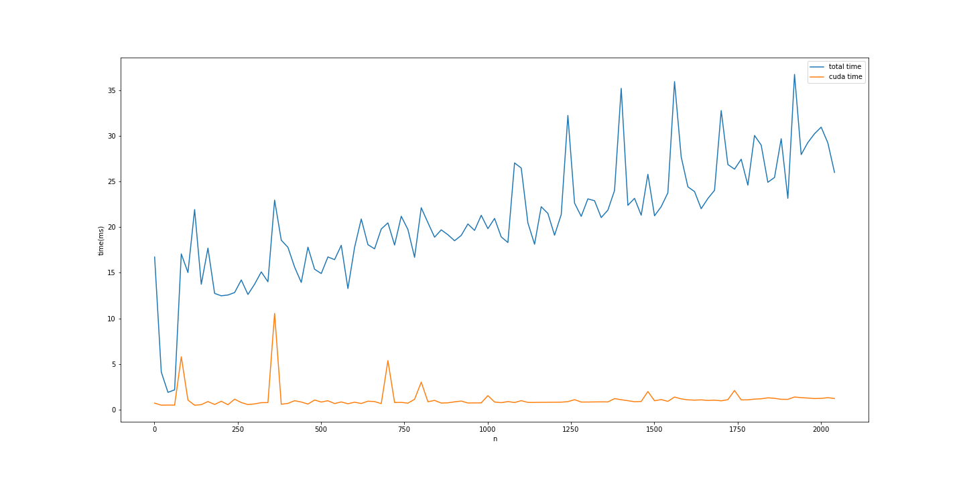
Plots
Most of the time is spent on the generation of random faults

Slide 7
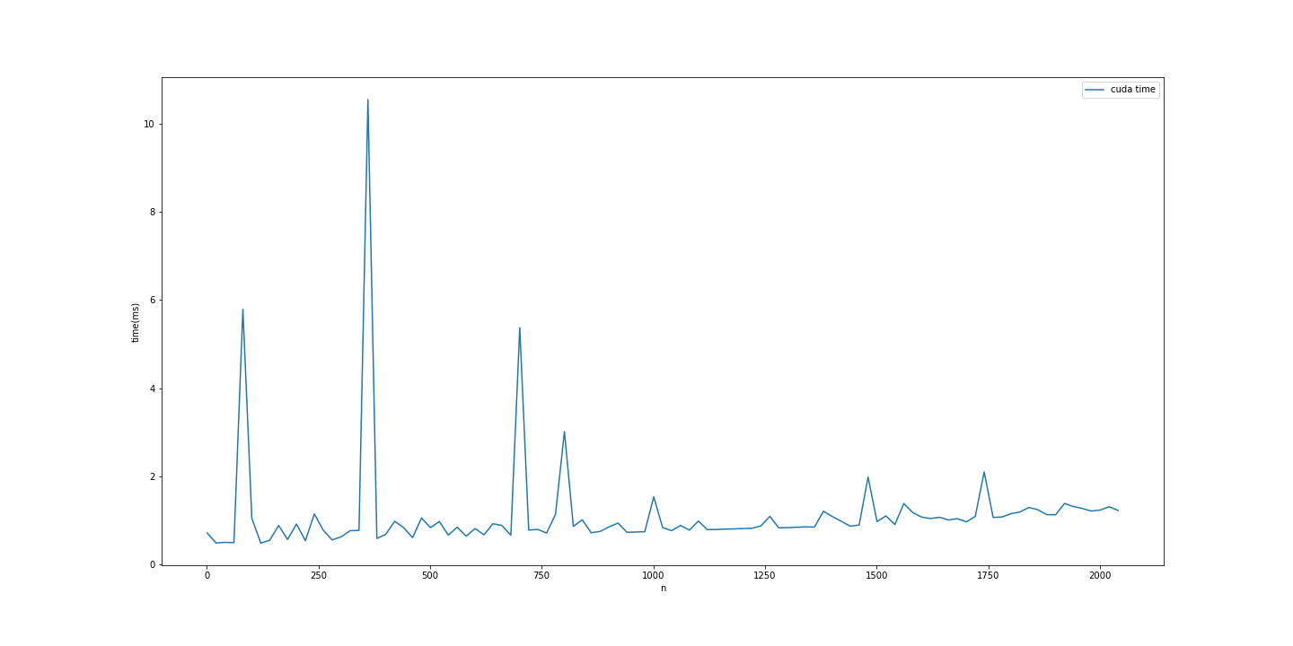
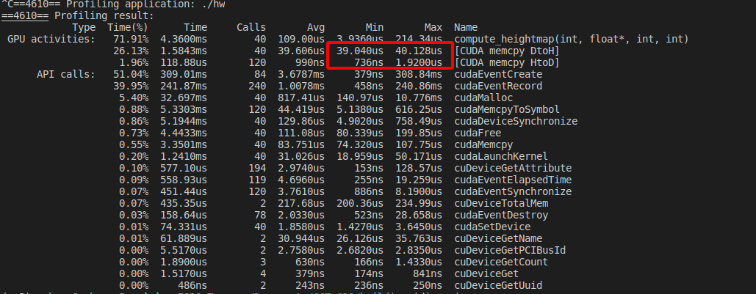
Plots
Kernel running time is almost proportional to N.
Not sure why spikes exist “regularly”
Not due to memory cpy, variance for memory transfer is too small

